Slide 1
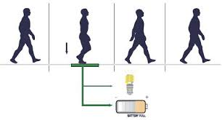
Foot step power generation system Under the guidance of MRS.CH.SRUJANA ASST.PROFESSOR
-Team Members: (IT-1)
A.SUMANA
2451-17-737-044
G.MANOGNA
2451-17-737-038
G.DS.SUBASH
2451-17-737-043

Slide 2
CONTENTS
INTRODUCTION
PIEZO ELECTRIC EFFECT
PIEZO SENSOR
FOOT STEP POWER GENERATION SYSTEM
CIRCUIT DIAGRAM
COMPONENTS REQUIRED
WORKING
APPLICATIONS
ADVANTAGES
DISADVANTAGES
CONCLUSION
REFERENCES
QUERIES

Slide 3
INTRODUCTION
Due to increase in demand of energy consumption for the devices we have to think over the alternative renewable energy in human surroundings.
So, either we need a long lasting battery or a smaller power generator which uses human power to generate electricity
Piezoelectric Effect is the best example to produce electricity by using the footstep power of the human body.

Slide 4
PIEZO ELECTRIC EFFECT
Piezoelectric Effect is the ability of some piezoelectric materials to generate an electrical charge in feedback to the mechanical stress. ‘Piezoelectric’ word is derived from the Greek word ‘piezein’ which means to push, squeeze and press.
Also, the piezoelectric effect is reversible, which means when we apply mechanical stress to the piezoelectric material we receive some electrical charge on output.
And, when we apply electricity to the piezoelectric material, then it compresses or stretch the piezoelectric material.

Slide 5
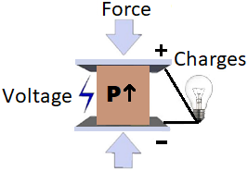
PIEZO ELECTRIC EFFECT

Slide 6
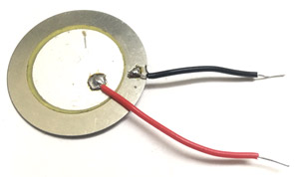
What is a piezo electric sensor?
A piezoelectric sensor is made up of piezoelectric material (quartz-most used). It used to convert the mechanical stress into electrical charge.
The output of the Piezoelectric Sensor is AC. We need a full bridge rectifier to convert it into DC.
The output voltage of the sensor is less than 30Vp-p, you can feed the output of piezoelectric sensor or can store it into battery or other storage devices.

Slide 7
FOOTSTEP POWER GENERATION SYSTEM
The system generates voltage using footstep force. The system serves as a medium to generate electricity using non conventional sources(force) and /store/use it.
The project is designed to be useful at public places like railway stations where a lot of people keep walking through all day. Systems are to be placed at any entry points where people travel through entrance or exits and they have to step on this device to get through.
These devices may then generate a voltage on every footstep and when mounted in series they will produce a sizeable amount of electricity.
For this purpose we here use piezoelectric sensors that use piezoelectric effect in order to measure acceleration, force, pressure by its conversion into electric signals.

Slide 8
Components required:
Piezoelectric Sensor
LED (Blue)
Diode (1N4007)
Capacitor (47uF)
Resistor (1k)
Push-button
Connecting Wires
Breadboard
Full wave bridge rectifier

Slide 9
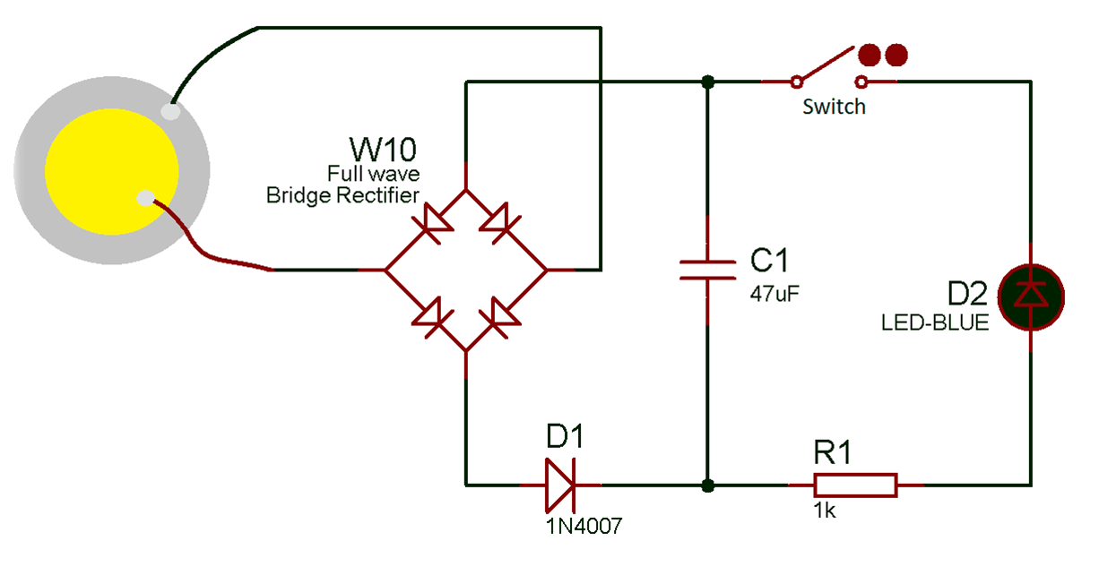
CIRCUIT DIAGRAM

Slide 10
WORKING
After making connections as per the Piezoelectric Sensor circuit diagram, when we provide mechanical stress to the piezoelectric sensor it generates voltage.
The output of the piezoelectric sensor is in AC form. For converting it from AC to DC we are using a full bridge rectifier. The output of the rectifier is connected across a 47uF capacitor.
The voltage generated by the piezoelectric sensor get stored in the capacitor.
And, when the push-button is pressed all the stored energy is transferred to the LED and LED turns ON till the capacitor get discharged.
In this circuit, the LED is glowing for a fraction of seconds. To increase the ON time of LED you can increase the capacitor rating, but it will take more time to charge. Also, the diode is used for blocking the current to flow from capacitor to piezoelectric sensor and the resistor is current limiting resistor

Slide 11

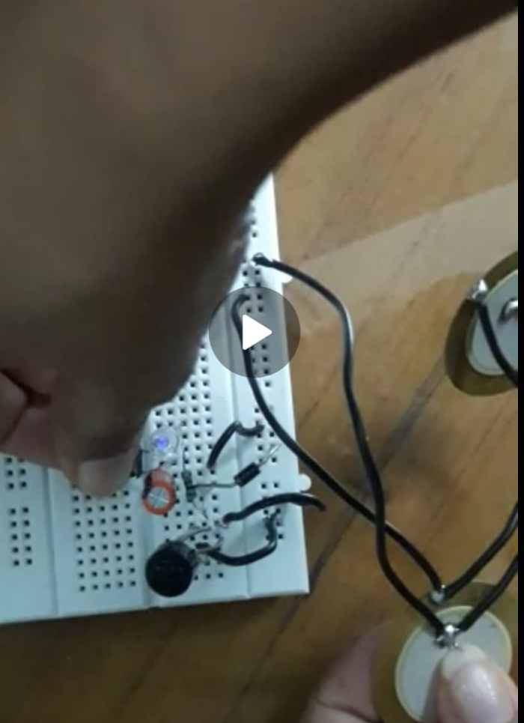
OUTPUT

Slide 12
APPLICATIONS
It can be used for agricultural, home applications, street lighting.
It can be used in emergency power failure situations
Metros ,rural applications etc

Slide 13
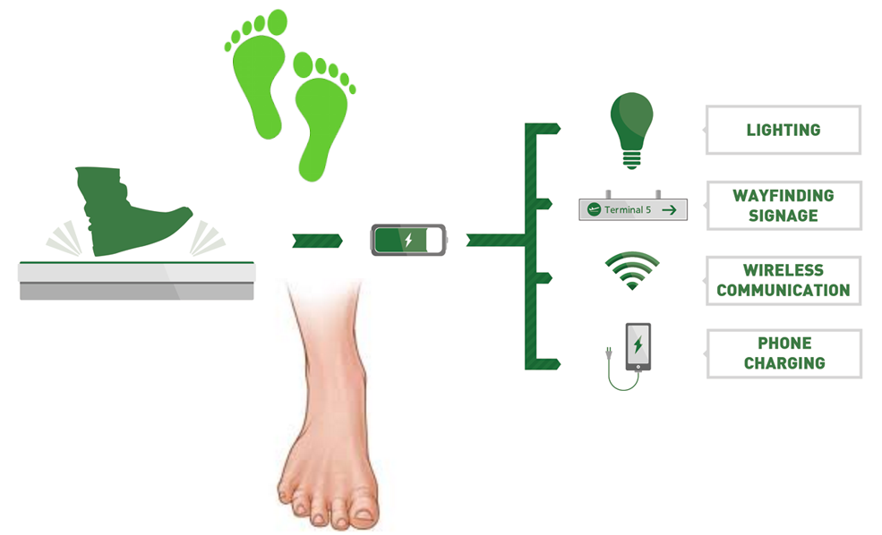

Slide 14
ADVANTAGES
Power generation is simply walking on step
No need of fuel input
This is a non conventional system
No moving parts-long service life
Self generating –no external power required
Compact yet highly sensitive

Slide 15
DISADVANTAGES
Only applicable for particular places.
Initial cost of this arrangement is high.
Output is affected by temperature variation.

Slide 16
CONCLUISON
Smart system
Produces 2000 watt of electricity
Durable
Have a life of approximately 5 years.

Slide 17
REFERENCES
www.google.com
www.circuitdigest.com

Slide 18
QUERIES?

Slide 19
THANK YOU

